Slide 1

Digimon Analyzer
NavBar
Search Site
Field Guide
About
Shop
Analyzer
History
Games
Movies
Merch
Anime
Games

Slide 2
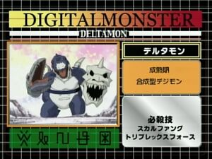
Analyzer in Detail
Grid Layout Background
Titel
Digimon Name
Type
Digimon Picture
Personality
Attack
Digimon Symbols
Fig.1: Digimon Analyzer from the anime
Notes:
The analyzer is the main part of the website. It provides information about a specific Digimon. By clicking on the picture a new site should open and provide the full digitation path. When clicking from that site on another Digimon it should pass an argument to the search query of the analyzer, execute the search on click and open a new digimon analyzer tab with information about the previously clicked Digimon.

Slide 3
Navigation
Analyzer

